Slide 1
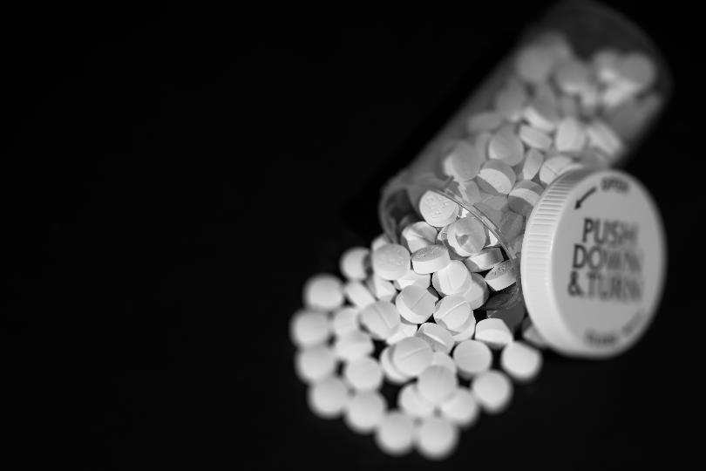
Module #3 Treatment of Opioid Withdrawal Syndrome and Opioid Use Disorder
Module Primary Author
Reuben Strayer
Authoring Group
Steven L. Bernstein, Kathryn Hawk, Lindsey Jennings, Lucinda Lai, Alexis LaPietra, Ryan McCormack, Lewis S. Nelson, and Reuben Strayer
Funding for this initiative was made possible (in part) by grant no. 1H79FG000021-01 from SAMHSA. The views expressed in written conference materials or publications and by speakers and moderators do not necessarily reflect the official policies of the Department of Health and Human Services; nor does mention of trade names, commercial practices, or organizations imply endorsement by the U.S. Government.

Slide 2
Learning Objectives
Compare abstinence therapy and opioid substitution treatment for opioid addiction.
Describe the unique pharmacological characteristics of buprenorphine that make it advantageous as an opioid substitution treatment for opioid addiction.
Explain the key elements in identifying appropriate candidates for ED-initiated buprenorphine.
Explain how to initiate buprenorphine in the ED.
2

Slide 3
Opioid Withdrawal is Hell on Earth
“It feels like the worst flu you ever had, the sickest you’ve ever been; at times, suicidal thoughts and complete and total confidence that you are never, ever, ever going to feel better.”
“For days I shook uncontrollably. I sweat through my sheets.”
“I wanted to tear my hair out of my skull and scratch my skin off of my body.”
“It feels like the day your wife left and your kitten died and there were no more rainbows anywhere and never will be again.”
3
Notes:
OWS can be literally unbearable. some people addicted to opioids would rather die than suffer OWS, they spend their lives terrified, moment to moment, of losing their supply of opioids and withdrawing. Once you understand this, the way that people with OUD behave makes a lot more sense.
quotes c/o Zack Repanshek

Slide 4
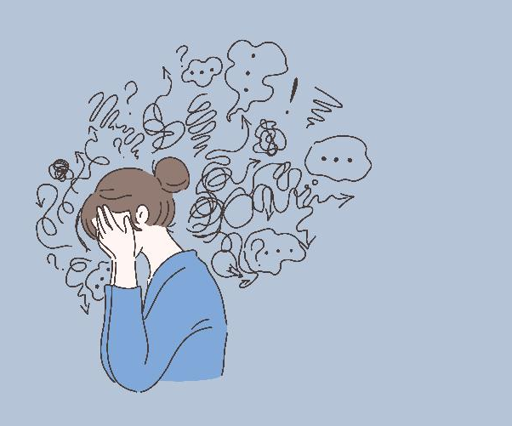
Opioid Withdrawal
Anxiety, irritability, restlessness, agitation
Diffuse pain, myalgias, arthralgias
Dysphoria, depression, hopelessness
Vomiting, diarrhea, abdominal cramping
Autonomic dysfunction
Sweating, tremors, increased HR/BP
Rhinorrhea, lacrimation
Mydriasis, yawning, piloerection
4
Notes:
Here are the main specific symptoms of opioid withdrawal. Humans have a natural system of endogenous opioid production that modulates opioid receptors all over the body. With daily exogenous opioid consumption, this system, which regulates our mood, GI motility, autonomic tone and of course pain, is thrown into disarray and when an opioid dependent person abruptly stops taking opioids, the effects are often dramatic across multiple organ systems.

Slide 5
Opioid Withdrawal
Non-Opioid Treatments
Dysautonomia: clonidine (dexmedetomidine, lofexidine)
Pain: NSAIDs, acetaminophen, gabapentin, baclofen, tizanidine
GI Distress: ondansetron, phenothiazines, antihistamines, loperamide, dicyclomine, octreotide
Agitation: antipsychotics, ketamine, careful with benzodiazepines
5
Notes:
There are a variety of non-opioid medications used to treat the symptoms of opioid withdrawal. the best known and most-studied is clonidine, a centrally acting alpha-two receptor agonist that acts as a sympatholytic. Though clonidine isn’t going to be sufficient for most patients by itself, it modestly improves the hyperadrenergic symptoms of opioid withdrawal and when combined with other agents can offer adequate symptom relief. there are a couple of clonidine analogs that have an evolving role in this context: dexmedetomidine, trade name precedex, is a parenteral alpha-2 agonist that has more pronounced CNS effects–sedation–compared to the hypotension and bradycardia you can see with clonidine. Dexmedetomidine is usually given intravenously as a loading dose followed by an infusion, though it can be used intramuscularly and may be a valuable addition to our sedative armamentarium for agitation of any sort, including opioid withdrawal, though data is at the moment quite limited. Lofexidine is another alpha-2 agonist that has been in use since the 1980s but was just approved by the FDA for the treatment of opioid withdrawal a few weeks ago and will be marketed in the US under trade name Lucemyra. Lofexidine has been demonstrated to be effective in treating some symptoms of opioid withdrawal with fewer cardiovascular effects than clonidine, however it is MUCH more expensive than clonidine, so not widely used at the moment.
Pain can be treated with simple analgesics, NSAIDs and acetaminophen. Because these patients are often not tolerating PO, ketorolac is often used. Muscle relaxant type drugs like gabapentin, baclofen and tizanidine are often used for patients with prominent myalgias and arthralgias.
OWS patients will often have severe vomiting, diarrhea, and abdominal cramping, and we can take the edge off of these symptoms with any of the usual therapies we offer to patients with GI distress, many of which also have analgesic or sedating effects, which is welcome in this context. ondansetron is commonly used, and the preferred phenothiazine is promethazine because it’s so sedating. antispasmodics and antidiarrheal medications like loperamide and dicyclomine are often used, as well as antihistamines like diphenhydramine or hydroxyzine.
In many cases, the non-opioid treatments that “work best” for patients with significant opioid withdrawal are the agents used to treat “agitation and restlessness:”antipsychotics like the sedating butyrophenones (haloperidol or droperidol) or newer drugs such as olanzapine, as well as ketamine, which is an analgesic, sedative, or anesthetic, depending on the dose. Benzodiazepines are of course very effective sedatives but be careful with benzos in OWS because they depress respiration, and if the withdrawal is precipitated (by naloxone), there may be a recrudescence of opioid toxicity where having benzos on board could be dangerous; or the patient may leave AMA and use opioids, which, combined with benzos, are particularly dangerous. We use these agents to treat agitation and restlessness but ‘agitation and restlessness’ should also be in quotes because what’s going on, when you use these powerful sedatives to treat opioid withdrawal, is you’re just snowing the patient.

Slide 6
Opioid Withdrawal
Non-Opioid Treatments
Clonidine 0.1-0.3 mg PO q1-3h
Dexmedetomidine start at 0.2 mcg/kg/min
Lofexidine 0.2-0.4 mg PO q6-12h
Ibuprofen 400-600 mg PO q4-6h
Ketorolac 15 mg IV/IM q4-6h
Acetaminophen 500-1000 mg PO q6h
Gabapentin 200-400 mg PO q6-8h
Baclofen 10 mg PO q8h
Tizanidine 4-8 mg PO q6-8h
Ondansetron 4-8 mg PO/IV q4-6h
Promethazine 25-50 mg IV/IM
Metoclopramide 10-20 mg IV q6-8h
Diphenhydramine 50 mg IV q6-8h
Hydroxyzine 50-100 mg PO/IM q4-6h
Loperamide 4 mg PO q4h
Octreotide 100 mcg SC q8h
Dicyclomine 20 mg PO q6h
Lorazepam 2-4 mg PO/IV q2-4h
Diazepam 10-20 mg IV q30-60 min
Midazolam 2-5 mg IM q2h
Haloperidol 2-10 mg IV/IM/PO q4-6h
Droperidol 1-5 mg IV/IM q4-6h
Olanzapine 5-10 mg IM q4h
Ziprasidone 10-20 mg IM q4h
Ketamine 0.25 mg/kg IV over 20 min q2h

Slide 7
Non-opioid treatments of opioid withdrawal do not address the underlying problem and are therefore relatively ineffective.
7
Notes:
And this points to one of the problems with the use of non-opioid medications to treat opioid withdrawal, which is that while you can take the edge off some of the symptoms, you’re not treating the problem, and so patients in severe opioid withdrawal are not going to be adequately managed with non-opioids for the same reason that a patient who has severe pain from appendicitis is not going to be adequately managed with opioids.

Slide 8
Because non-opioid treatments of opioid withdrawal are relatively ineffective, the patient’s ED course is often difficult and protracted.
8
Notes:
And because clonidine, ibuprofen and phenergan don’t address the problem, which is a billion screaming mu receptors, they don’t work well, so trying to make the patient comfortable enough to be discharged often doesn’t work unless you sedate the patient to unconsciousness, at which point they still can’t be discharged because they’re unconscious and you end up with these 5, 10, 15 hour ED stays where everyone is miserable, the patient, the nurse, the doctor, the other patients…

Slide 9
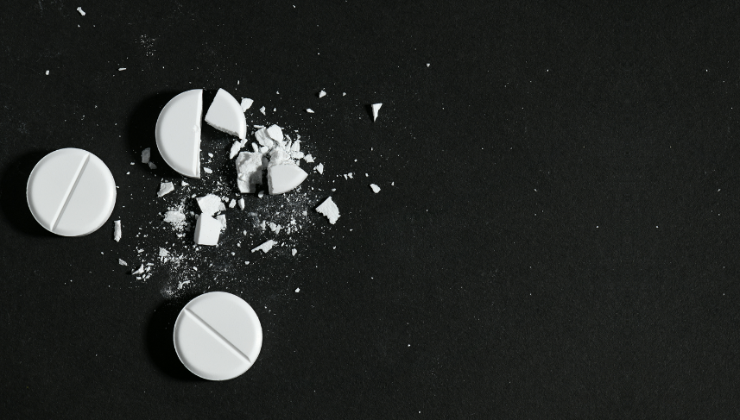
Non-opioid treatments do not address cravings, which leaves the patient much more vulnerable to self-treating with street drugs, which are more lethal than ever before.
9
Notes:
Even if you can control the somatic symptoms well enough to discharge the patient, when you treat withdrawal with non-opioids the patient is still left with the deranged brain chemistry that causes cravings, cravings that last for months if not years even if abstinence is achieved, and are fed by feelings of dysphoria and despair which make the patient highly vulnerable and highly likely to self-treat with street opioids. and contemporary street opioids are no longer just oxy and heroin, they’re fentanyl and carfentanyl. Given how dangerous street opioids now are, discharging an opioid dependent person in withdrawal is a very dangerous discharge.

Slide 10
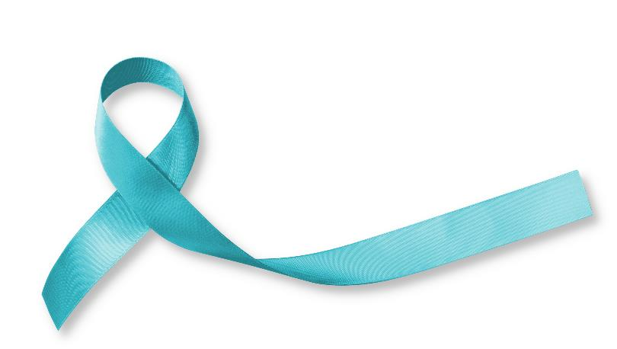
Treating withdrawal with non-opioids misses the opportunity to move the patient to recovery with MOUD.
10
Notes:
And we now have a powerful alternative, to initiate the best treatment for OUD in the emergency department. This used to be exclusively the domain of addiction specialists, but emergency providers are now empowered to move patients with opioid use disorder to recovery using medications for opioid use disorder.

Slide 11
Opioid Withdrawal Treatment with Methadone
10 mg IM or 20 mg PO
Cannot be prescribed by emergency providers
Full agonist harms
Respiratory depression
Does not offer blockade/protection
Misses the opportunity to initiate buprenorphine
Second line agent after buprenorphine
Notes:
There are two opioid agonists used for medication assisted treatment, the first is methadone. methadone is a long acting full mu receptor agonist and treating the patient with 10 mg IM or 20 mg PO will reliably abolish withdrawal symptoms and cravings in most patients. IM is preferred to guarantee drug delivery, especially in the vomiting patient.
Using methadone to treat opioid withdrawal is preferable to non-opioids in most circumstances, but there are a few problems with methadone, and the first is that you can’t prescribe it for addiction, so it’s a very temporary solution.
and because it’s a full agonist, it’s associated with all the harms of the full agonists, most importantly respiratory depression. so the withdrawal patient treated with methadone and discharged, who then uses street opioids, will in some cases be particularly susceptible to respiratory depression from the methadone plus whatever they’re using on the street. And methadone offers no protection against the dangerous effects of street opioids, whereas the patient treated with buprenorphine is relatively safe from overdose while they are therapeutic on bup
buprenorphine is a much better option because it’s so much safer than methadone, blocks the action of other opioids (like unpredictable street opioids), and can acquired by prescription; so treating OWS with methadone misses the opportunity to initiate bup.
Methadone should therefore be thought of as a second line agent in the treatment of opioid withdrawal or opioid use disorder, after methadone. Patients who are already enrolled in a methadone program should generally be treated with a withdrawal suppression dose of methadone, as we will discuss in a moment, but most other patients in withdrawal should be treated with buprenorphine.

Slide 12
Opioid Withdrawal Treatment with Buprenorphine
Partial opioid agonist
Ceiling effect
Much safer
Less euphoriant
Higher receptor affinity than almost any other opioid
Will precipitate withdrawal if not in withdrawal
Less abuse-prone and blocks more abuse-prone opioids
Buprenorphine is uniquely suited to treat opioid addiction: less dangerous, less abuse-prone vs. methadone, more likely to abolish craving, protects users from OD by more dangerous opioids
Notes:
buprenorphine is a pharmacologically complex and extremely cool drug that has not been in the emergency provider’s toolbox, until now.
Buprenorphine is a partial mu receptor agonist which means that there is a ceiling effect to both its euphoriant potential and its toxicity - buprenorphine is remarkably safe in overdose–you can still die by overdosing on bup–especially with coingestants–and many people have–but it is much, much safer than methadone.
at the same time, buprenorphine has a higher affinity for the mu receptor than just about every other opioid, which is very important because if you have oxy or heroin in your system and you take bup, the bup will replace them on the mu receptor, but because bup is a partial agonist replacing a full agonist, the patient will withdraw. So buprenorphine is very effective at relieving withdrawal symptoms for most opioid dependent patients, but if an opioid dependent patient is not in withdrawal, buprenorphine will precipitate withdrawal.
Partial agonism means you do not get high in the same way that you do with other opioids and when you have bup in your system heroin and oxy won’t work, because bup has a higher receptor affinity, this is called buprenorphine blockade.
So buprenorphine at its best abolishes withdrawal, abolishes cravings, and protects the patient from overdose and other opioid abuse harms, it seems like the perfect drug to treat opioid addiction.

Slide 13
Opioid Withdrawal Treatment with Buprenorphine
Buprenorphine + naloxone = Suboxone
Naloxone additive is poorly absorbed in most patients unless injected
Naloxone component is designed to prevent abuse
Some patients experience naloxone effect
Appropriate to stock monoproduct in ED for directly observed administration
Slow acting and long acting
Reduces abuse potential + ceiling effect = long dosing intervals
72-hour rule
Providers without X-waiver can dispense buprenorphine daily for 3 days
13
Notes:
but of course it’s not perfect. Buprenorphine itself is can be abused, especially when it’s crushed and injected, so the preferred preparation when bup is used to treat addiction is the combination of buprenorphine and naloxone, best known by its trade name Suboxone but now available as generic bup-nalox. The naloxone component has minimal bioavailability and for most patients has minimal effect when suboxone is taken under the tongue as intended; the naloxone component is designed to only act as a mu receptor antagonist when the drug is abused by injecting it. The purpose of the naloxone in Suboxone is only to prevent abuse by injection, and for most patients it has no other effect, and the withdrawal that can be seen when bup-nalox is taken sublingually is precipitated by the buprenorphine itself, not the naloxone.
However, despite the classic teaching, it has become clear that a minority of patients will experience what is usually mild forms of precipitated withdrawal from the naloxone, even when the drug is taken properly. Furthermore, though the monoproduct (without the naloxone additive) has higher street value, we know that the addition of naloxone to the bup has at best a modest effect on preventing abuse. Therefore, it is appropriate to use the monoproduct instead of the combination product when administering the drug in the ED, and patients who say they do better with the monoproduct should be prescribed the monoproduct, unless there is a significant concern for diversion.
Buprenorphine is relatively slow onset, which further reduces its abusability and like methadone has a long, dose-dependent duration of action, but because of its ceiling effect, can be used safely in ridiculously high doses to prolong the interval to 3 days, 4 days, even 5 days, extremely cool.
All clinicians can administer buprenorphine in the ED to treat opioid withdrawal in the ED but to write an outpatient prescription for buprenorphine for addiction for the moment at least requires a special addendum to your DEA license called an X-waiver, which for physicians means an application process and 8 hours of training. There is widespread and mounting support to deregulate buprenorphine, to X the X waiver, but this requires an act of congress so until that happens everyone can write for oxycontin, a massively dangerous, massively abuse-prone opioid, but in order to prescribe buprenorphine, a comparatively safe opioid that treats addiction, you have to jump through a series of hoops so very few docs can prescribe bup.
However after you administer in the ED, which everyone can do, the patient can return to the ED for up to 72 hours to receive further doses of buprenorphine (by a non-waivered provider). So you don’t need a cohort of waivered providers to initiate bup in the ED, you can administer the drug for 3 days whether waivered or not, which is long enough in most settings to get the patient to a clinic-based waivered provider.

Slide 14
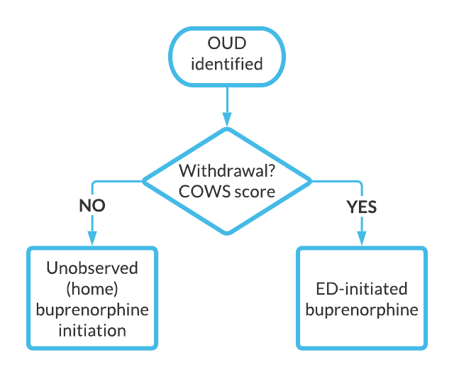
Opioid Withdrawal Treatment with Buprenorphine
Harm reduction, peer support
Referral to comprehensive addiction care
Ideally with warm handoff
14
Notes:
patients with OUD who are not already enrolled in an MOUD-based treatment program should all be offered MOUD treatment. if the patient is withdrawing, this represents a particularly important moment both because of how vulnerable OUD patients in withdrawal are, and that being in withdrawal facilitates treatment with buprenorphine.
we use the clinical opiate withdrawal scale, which can be performed very quickly and scores withdrawal severity from 0 to 48, the higher the score, the better buprenorphine will work. If the score is zero or very low, there is the risk that buprenorphine will precipitate withdrawal, but many of these patients will do very well with unobserved (home) initiation, which requires a waivered prescriber to write a prescription, and the patient has to be able to fill that prescription.
all patients with OUD should receive harm reduction efforts [see next module] and a referral to outpatient comprehensive addiction care. the more robust the follow-up, the better; ideally an appointment would be made for the patient and the ED provider would speak with the outpatient provider in a warm handoff.

Slide 15
Precipitated Withdrawal
Withdrawal caused by naloxone (or buprenorphine)
Treatment is controversial
Buprenorphine probably works for most patients
Classic treatment is with non-opioids
May require aggressive sedation until antagonist wears off
Harm reduction + reassessment for MOUD
15
Notes:
When an opioid-dependent person stops using, eventually they will develop spontaneous or abstinence withdrawal. Precipitated withdrawal occurs suddenly, when an opioid-dependent person is exposed to an antagonist or partial agonist. Precipitated withdrawal can be very severe and occasionally dangerous in patients who cannot tolerate the extreme hyperadrenergic state.
the most common case is the opioid overdose patient who is rescued with naloxone and is now in precipitated withdrawal. These patients are often distressed and miserable. Theoretically ideal treatment is to use buprenorphine to simultaneously treat withdrawal and transition the patient to OUD treatment, and early data suggests that this works–the dose is 16 mg SL, with up to another 16 mg if needed. However this approach may not always work, and the pharmacology can be complex. At the moment, providers who treat naloxone-precipitated withdrawal with buprenorphine should verbally consent the patient and be ready to manage both failure to alleviate withdrawal symptoms and the development of opioid toxicity (both appear to be distinctly uncommon, but, again, data and experience are very preliminary).
The classic approach is to use non-agonists. this generally works reasonably well for NPW, as naloxone is relatively short lived. Once the naloxone has worn off (2-3 hours), the patient should be offered harm reduction maneuvers and reassessed for candidacy for MOUD. Precipitated withdrawal can be very severe and may require high doses of multi-modal therapy.
Buprenorphine-precipitated withdrawal is probably best treated with more buprenorphine (≥16 mg), though, again, experience and data are quite limited. Non-agonist treatment may also be effective, but given the long half-life of bup, may require long durations of treatment.

Slide 16
Missed Methadone
Contact the prescriber/clinic.
Most MMT patients can miss a single dose without developing withdrawal.
If withdrawal symptoms are present and the patient is going to be discharged, give the patient a withdrawal suppression dose of 10 mg IM or 20 mg PO.
If admitted, a full dose can be given after discussing with the methadone prescriber/clinic.
Notes:
many emergency departments frequently care for patients who have missed their methadone dose. these patients may present specifically for this reason, or they may have another problem (MVC, pneumonia, etc) that caused them to seek care and miss their methadone dose.
whenever a patient on methadone maintenance treatment (MMT) presents to the ED with missed methadone, the clinic/prescriber should be contacted. it is common for patients to present after the clinic has closed, however.
methadone has a very long half-life and most MMT patients can miss a single dose without developing any withdrawal symptoms whatsoever. patients with complaints of missed methadone who do not have any objective signs of withdrawal are appropriately managed with no treatments (or non-agonist treatments) and referral back to their clinic the following day.
if signs or concerning symptoms of withdrawal are present, the appropriate management is to provide a withdrawal suppression dose of methadone, which is 10 mg IM or 20 mg PO. All else being equal, IM is preferred as absorption is guaranteed. there are several reasons why MMT patients presenting with missed methadone and expected to be discharged should not be given their full dose, even if their dose is confirmed with the clinic, having to do with how dangerous methadone is (compared to bup), how unreliable even confirmed dosing is, and continuity of care.
patients being admitted can be given a withdrawal suppression dose until a conversation is had with their MMT prescriber/clinic, at which point the patient can (and should) receive their usual daily dose of methadone each day of their hospital admission.

Slide 17
Key Points
Opioid withdrawal is hell on earth.
Patients may suffer from dysphoria, anxiety, sever pain, and GI distress
A variety of non-opioid therapies can improve symptoms
Opioid agonist therapies offer many advantages, including moving patient to recovery with MOUD
17

Slide 18
References
Herring AA, Perrone J, Nelson LS. Managing Opioid Withdrawal in the Emergency Department With Buprenorphine. Ann Emerg Med. 2019 May;73(5):481-487.
Cisewski DH, Santos C, Koyfman A, Long B. Approach to buprenorphine use for opioid withdrawal treatment in the emergency setting. Am J Emerg Med. 2019 Jan;37(1):143-150.
D'Onofrio G, McCormack RP, Hawk K. Emergency Departments - A 24/7/365 Option for Combating the Opioid Crisis. N Engl J Med. 2018 Dec 27;379(26):2487-2490.

