Slide 1
Successfully Flipping the Classroom for YOUR Conference
Andrew King, MD, FACEP
Assistant Professor and Assistant Program Director
CORD Adult Learner 560 Session 7 March 2016

Slide 2
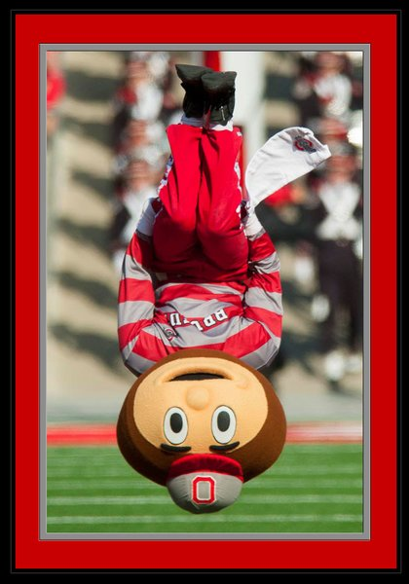
CORD 560 Adult Learners
Adult Learning Problem Identified
Traditional Lectures
Literature Based “Flipped” Classroom Approach
  Self-Directed Learning
  Small Group Discussions

Slide 3

CORD 560 Adult Learners
OBJECTIVES
Utilize Medical Education Literature to Convey the Effectiveness of “Flipped” Classroom Approach
Discuss The Ohio State University Approach to the “Flipped” Classroom Model
Describe the Successful Aspects and Challenges of Our Curricular Innovation

Slide 4
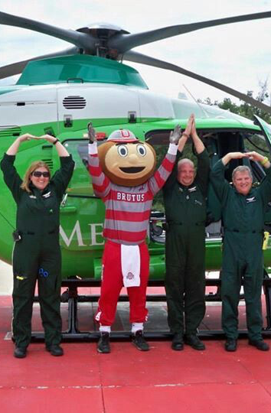
CORD 560 Adult Learners
Why Utilize a “Flipped” Classroom?
Resident preference for learning activities that are case/skill based, applied new knowledge, and small groups
Potential for formal assessment and required participation
Tan E, Brainard A, Larkin G. “Acceptability of the flipped classroom approach for in-house
teaching in emergency medicine.” Emergency Medicine Australasia (2015) 27: 453-459.
doi: 10.1111/1742-6723.12454

Slide 5
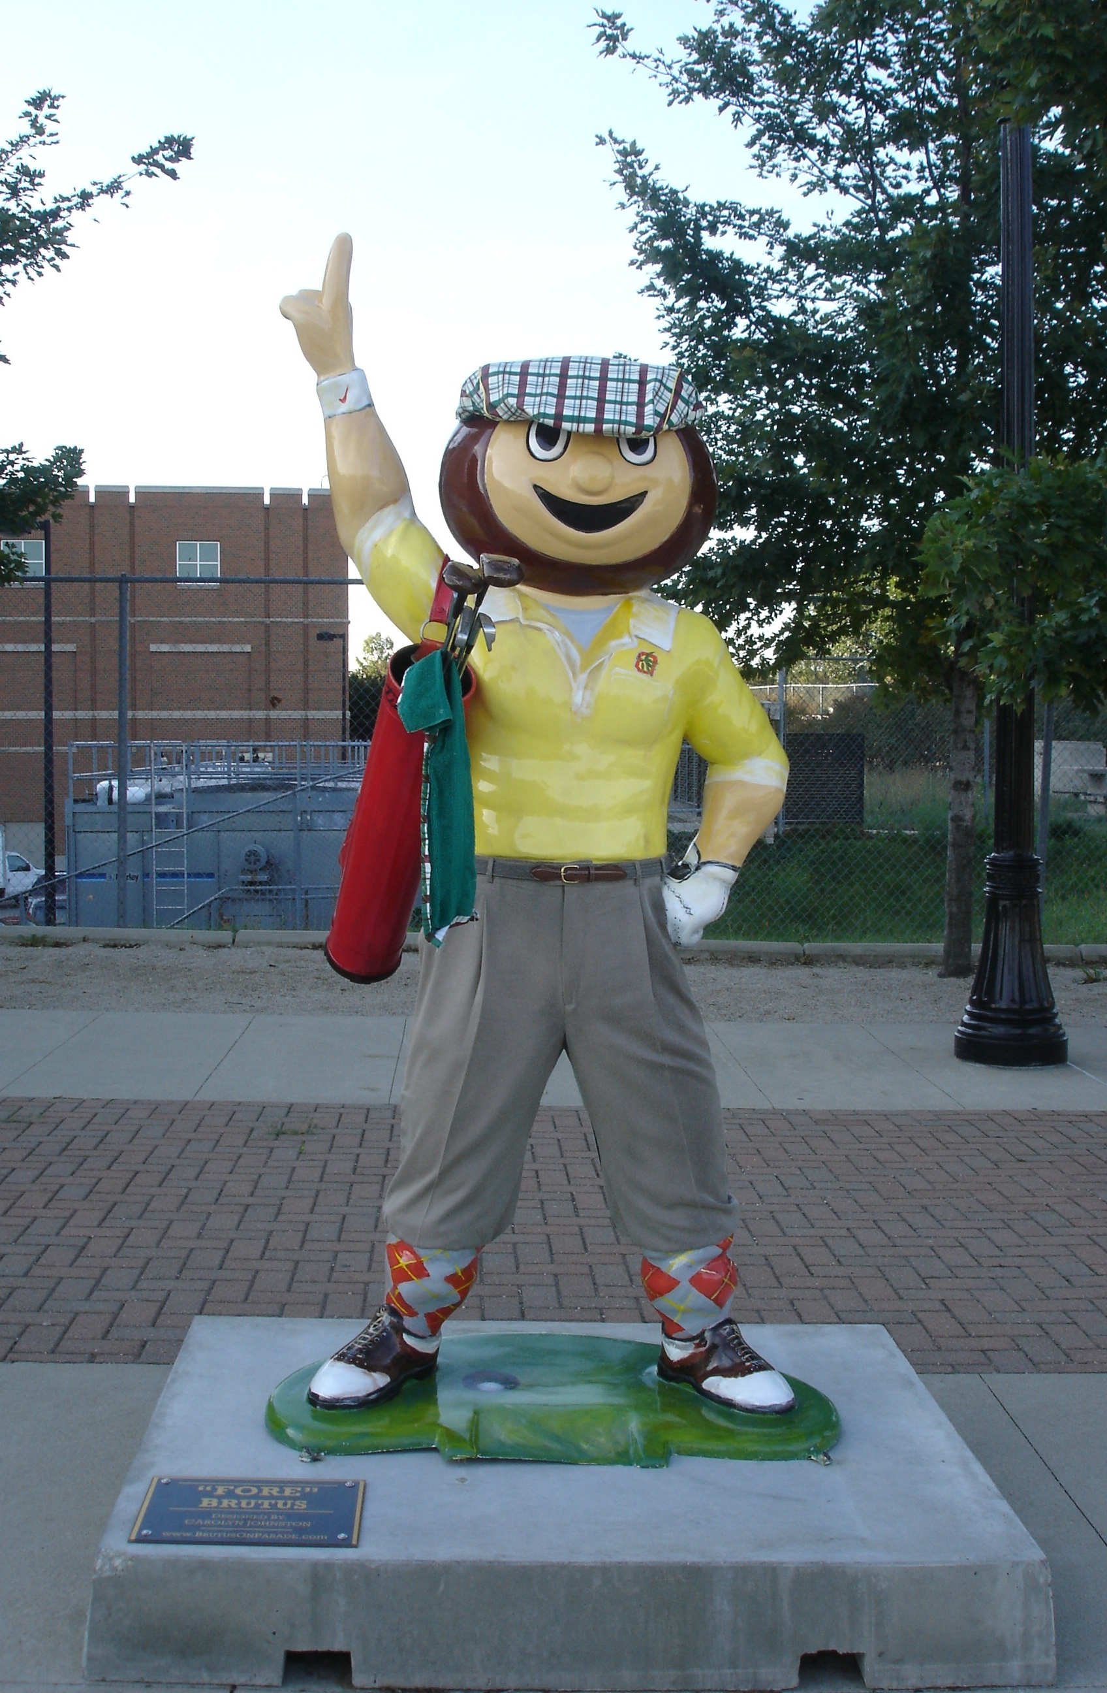
CORD 560 Adult Learners
Why Utilize a “Flipped” Classroom?
Individualized learning and ability to incorporate EBM
Time optimization by increasing educator-learner interaction time
Accountability and assessment opportunities
Moffett J. “Twelve tips for “flipping” the classroom.” Medical Teacher 37:4 331-336. doi: 10.3109/0142159X.2014.943710

Slide 6
CORD 560 Adult Learners
Small Group Session
Case Based Discussions and Clinical Controversies
Self Directed Exercise (“Priming”)
Pathophysiology
Clinical Presentation
Diagnosis
Management
1-2 Remaining Questions (After reviewing material)
Reviewed by Faculty
Small Group Session
Completion of Quiz and Development of Independent Learning Plan (ILP)
M/M Utilizing Cognitive Autopsy or “Rapid-Fire” Case Review
Simulation and Procedure or EBM
Assessments of Procedure Skills and Difficult to Assess Milestones
45 min, revolving

Slide 7
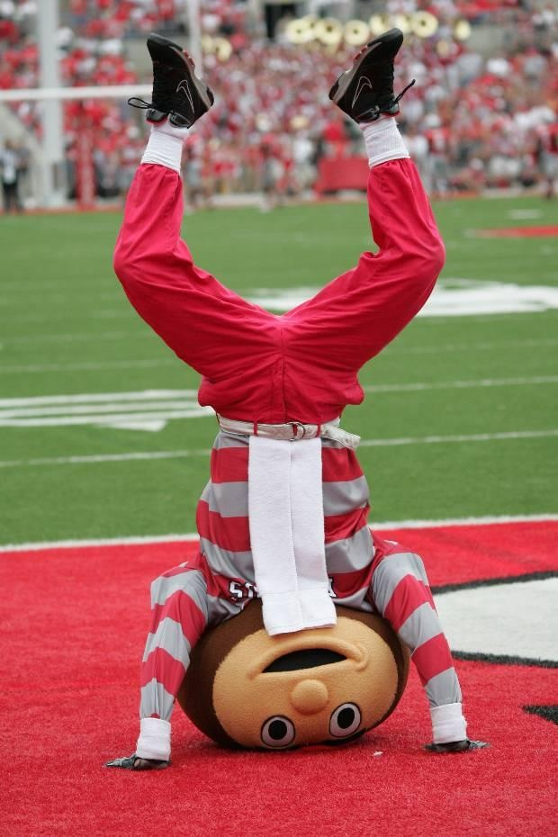
CORD 560 Adult Learners
Frequent Simulation Sessions
Assess Milestones Routinely Identified as Difficult to Assess
Emergency Stabilization (PC1) Level 3 – evaluates the validity of a DNR order
Professional Values (PROF1) Level 3 and 4 – alternative care plans (level 3) and ethical issues in complicated and challenging clinical settings (level 4)
Patient Safety (SBP1) Level 4 – leads team reflection
Patent Centered Communication (ICS1) Level 4 – flexible communication strategies to resolve specific ED challenges such as delivering bad news and drug seeking behavior

Slide 8
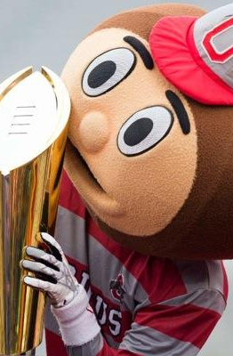
CORD 560 Adult Learners
ASPECTS OF OUR SUCCESS
Overwhelmingly Positive Feedback and Increased Resident Involvement
Department Dedicated to Resident Education and Our Innovation
Remains Dynamic to Further Improve Design
Organization, Scheduling, and Accountability Maintained by Program Coordinator

Slide 9
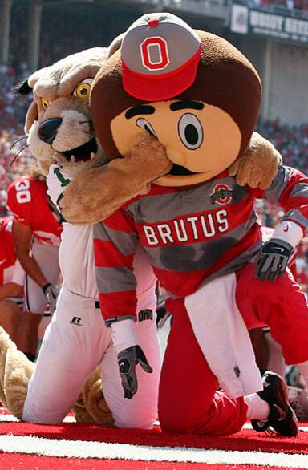
CORD 560 Adult Learners
CHALLENGES EXPERIENCED
Complacency and “if it isn’t broke then don’t fix it mentality”
GME Faculty/Residents Skeptical and Resistant to Increased Workload
Scheduling and Organization

Slide 10
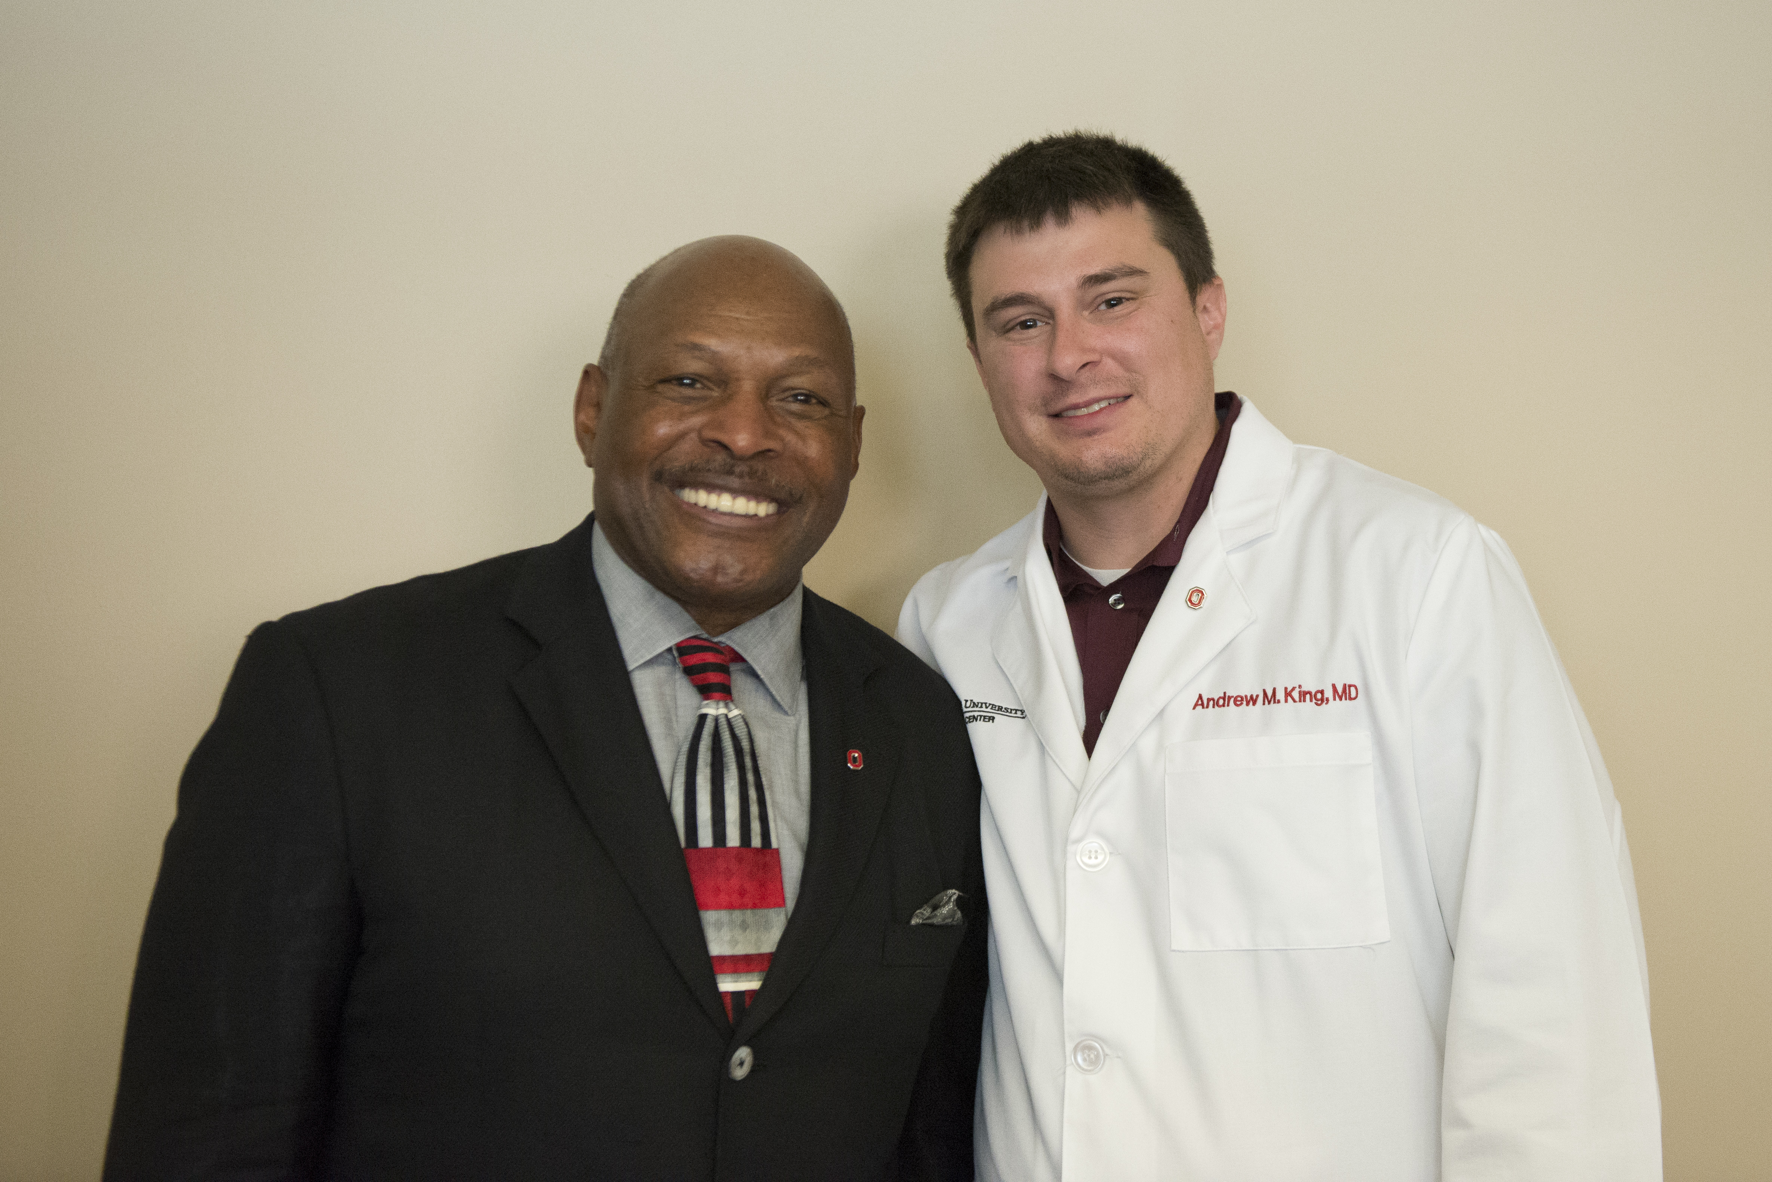
CORD 560 Adult Learners
Detailed Handout Available
Questions: andrew.king3@osumc.edu
Archie Griffin – CFB Only 2x Heisman Trophy Winner
Provided Guest Lecture on Leadership
Special Thanks: Sorabh Khandelwal, MD and Sarah Greenberger, MD

